Slide 1
Customer Feedback Dashboard
Group members:
Watsamon Phongwanit
2010160002
Karnsiree Karnka
2010160003
ITE354 Final Project

Slide 2
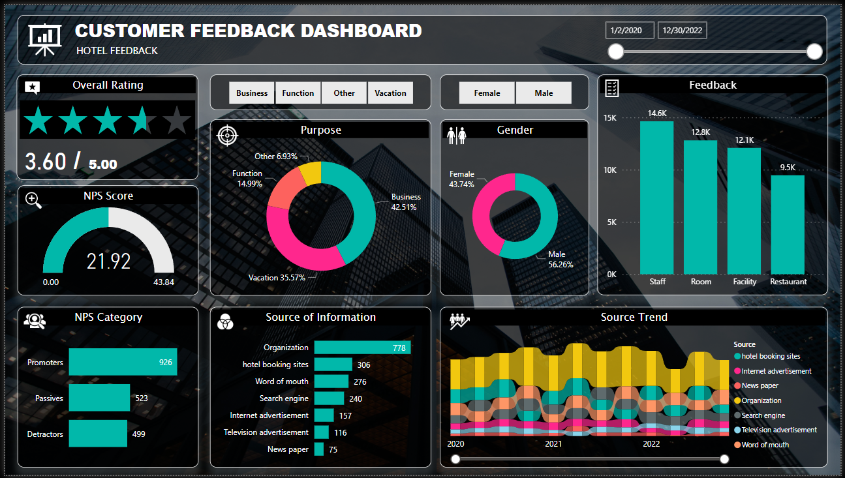

Slide 3
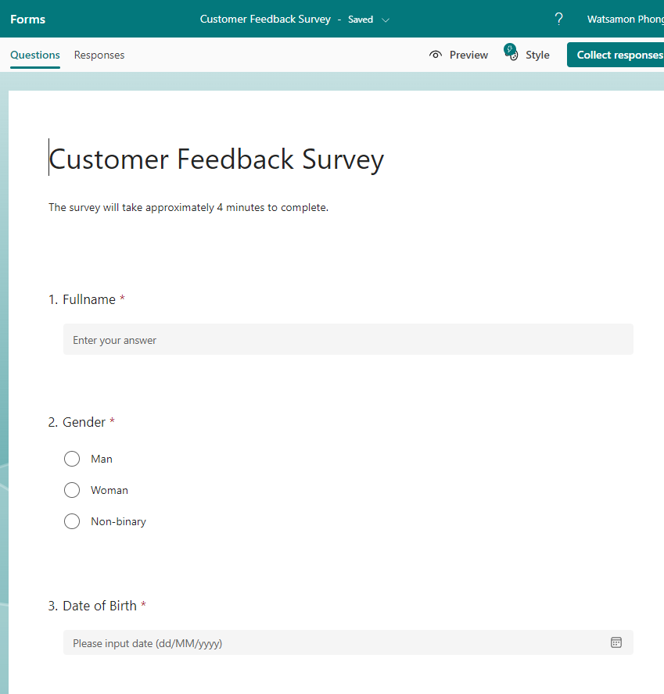
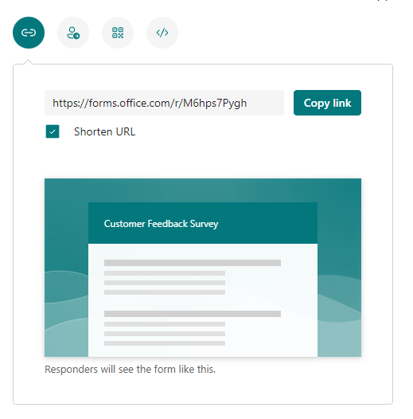
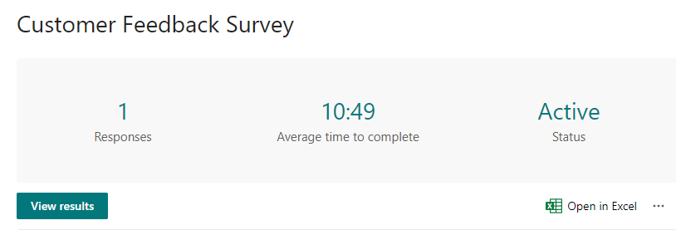
Data Acquisition
Microsoft form survey
Share URL
Mail
QR code
Embedded html
Social media
Variety ways to collect data
Convert to excel and export to Power BI
Notes:
First we do data acquisition
By using customer survey created by microsoft form
This forms can be shared in so many ways to collect data including
sharing the direct URL
sharing to social media
Sending via email
it can also generate QR code and embedded html to post on pages and websites.
The collected data can be open in excel which you can save and open it on Power bi

Slide 4
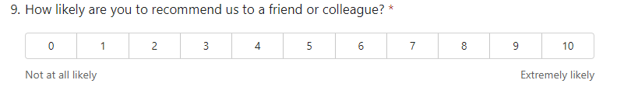
Data Acquisition
We use this question on our survey to obtain NPS score
NPS (Net Promoter Score) is a metric used to gauge customer satisfaction.
The respondents were divided
Promoters (9-10 rating)
Passives (7-8 rating)
Detractors (1-6 rating)
NPS = Percentage of Promoters - Percentage of Detractors
Notes:
We use this question on our survey to get the NPS score for our business
NPS (Net Promoter Score) is a metric used to gauge customer satisfaction
The respondents f this surverys were divided
Promoters (9-10 rating)
Passives (7-8 rating)
Detractors (1-6 rating)
and NPS is calculated by Promoters % - Detractors %

Slide 5
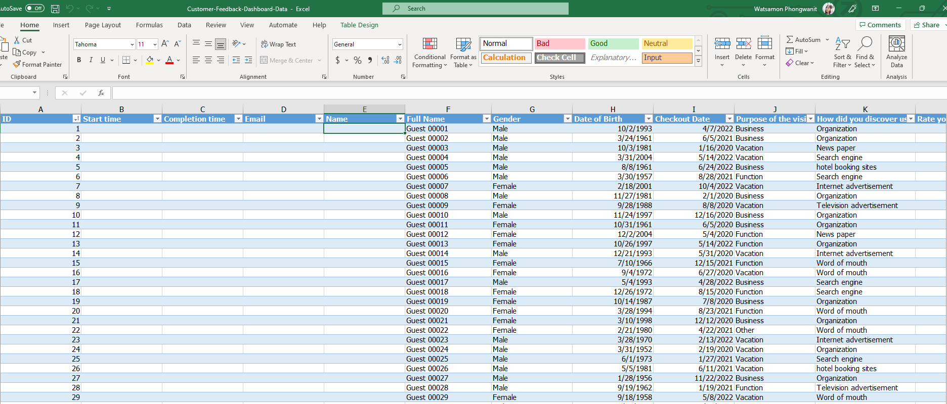

Mock data
Notes:
For this project we use a mock data

Slide 6
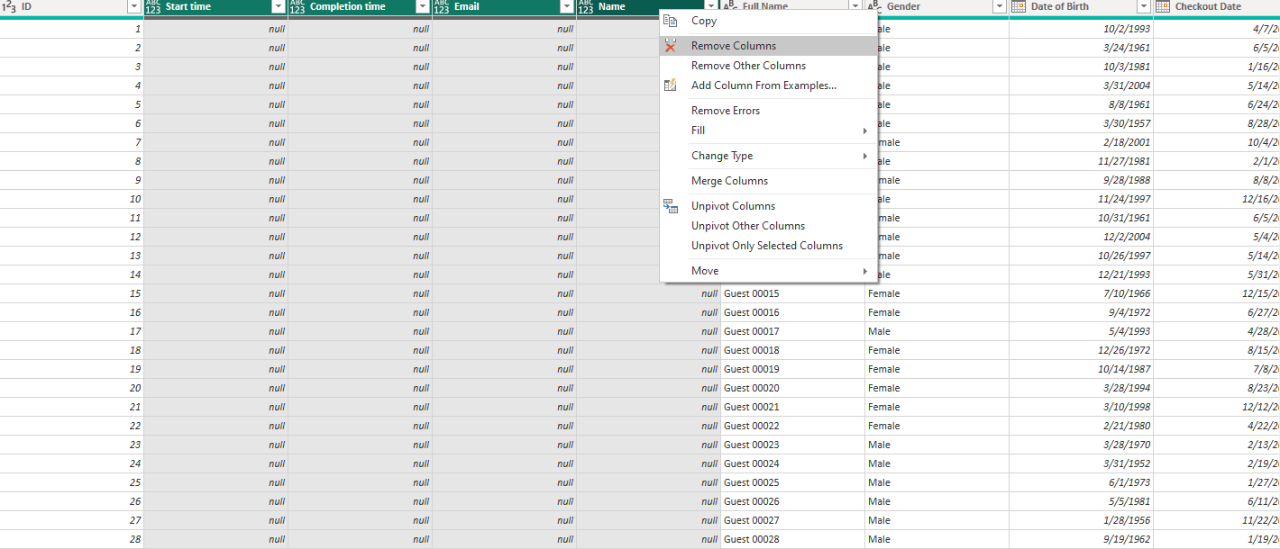
Data Transformation
2. Remove irrelevant data
Notes:
After importing data to power bi
we remove some irrelevant columns from the table
these data were auto-generated by the microsoft excel survey

Slide 7
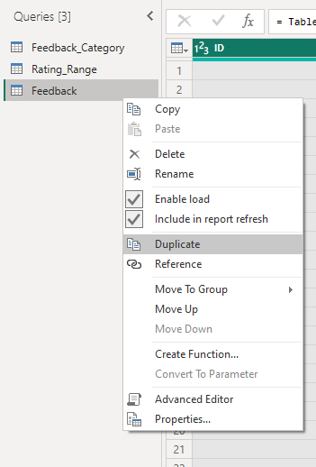
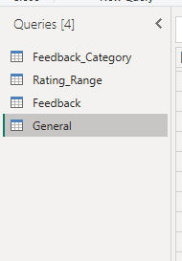
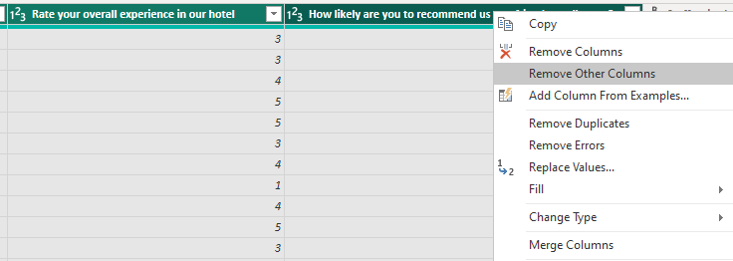
Data Transformation
Separate feedback table by duplication:
General questions
Feedback questions
Rename the table and remove
irrelevant column from each table
*Customer ID for each table will be kept because it is a primary key!
Separate feedback table
Notes:
Separate feedback tables:
General questions (purpose of the visit,source of information,overall rating)
Feedback (staff , room services)
Then we rename the table and remove irrelevant column from rach table
however, the customer ID which is a unique number will remain on each table because it is a primary key.
(We will use it to link both tables together later on)

Slide 8
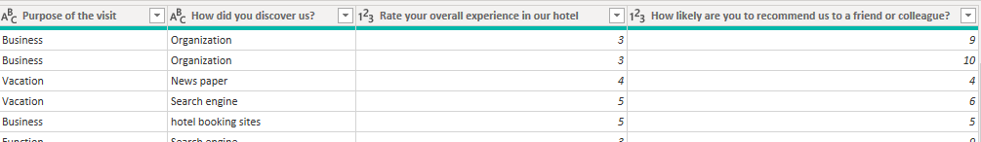
Data Transformation
Feedback table
Rename columns
Notes:
Separate feedback tables:
General questions (purpose of the visit,source of information,overall rating)
Feedback (staff , room services)
Then we rename the table and remove irrelevant column from rach table
however, the customer ID which is a unique number will remain on each table because it is a primary key.
(We will use it to link both tables together later on)

Slide 9
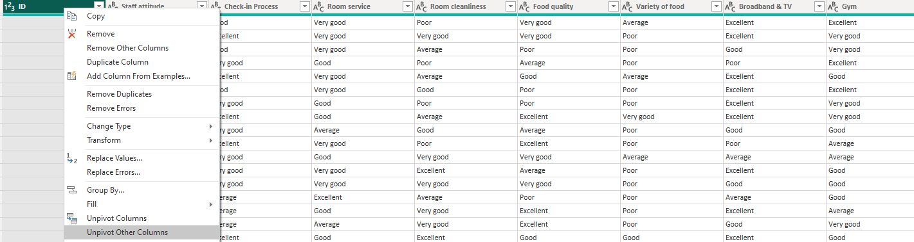
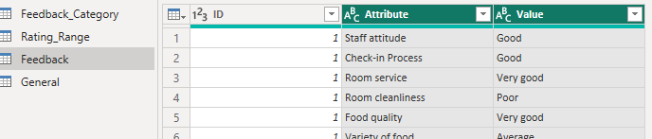
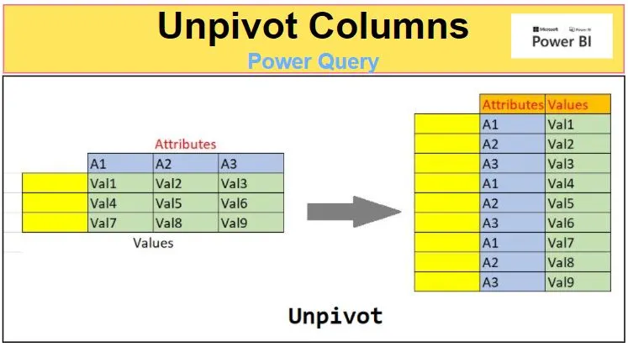
Feedback table
Transform data into three columns according to ID :
ID
Feedback
Rating
Unpivot ID columns
Notes:
Next we unpivot the ID column
which will translate all other columns into attribute-valued pairs (translate all the other headers into rows)

Slide 10
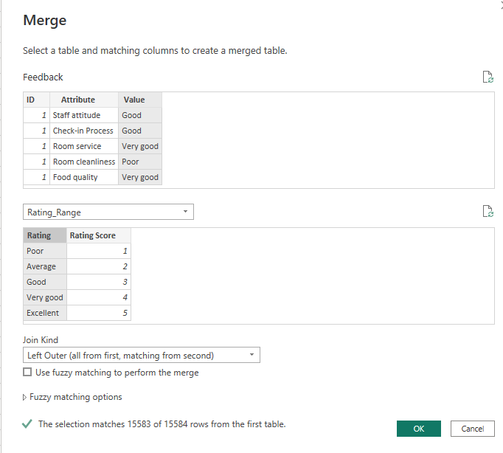
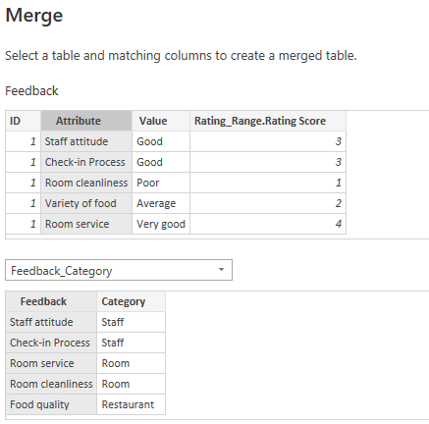
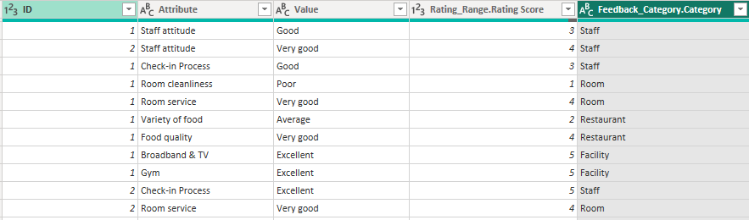
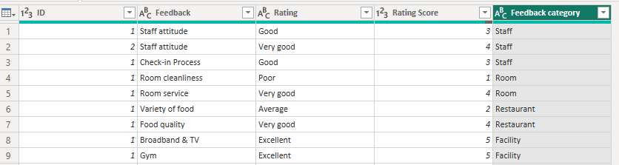
two new merge columns
merge queries
renaming
Merge Queries
Notes:
This step is required because we want to view the performance of each categories by numerical rating, not text
as it will be required in the calculation of NPS afterwards.
Thus we create this Rating_range table to merge to merge with rating values
and Feedback_Category table to merge with each type of feedback category

Slide 11
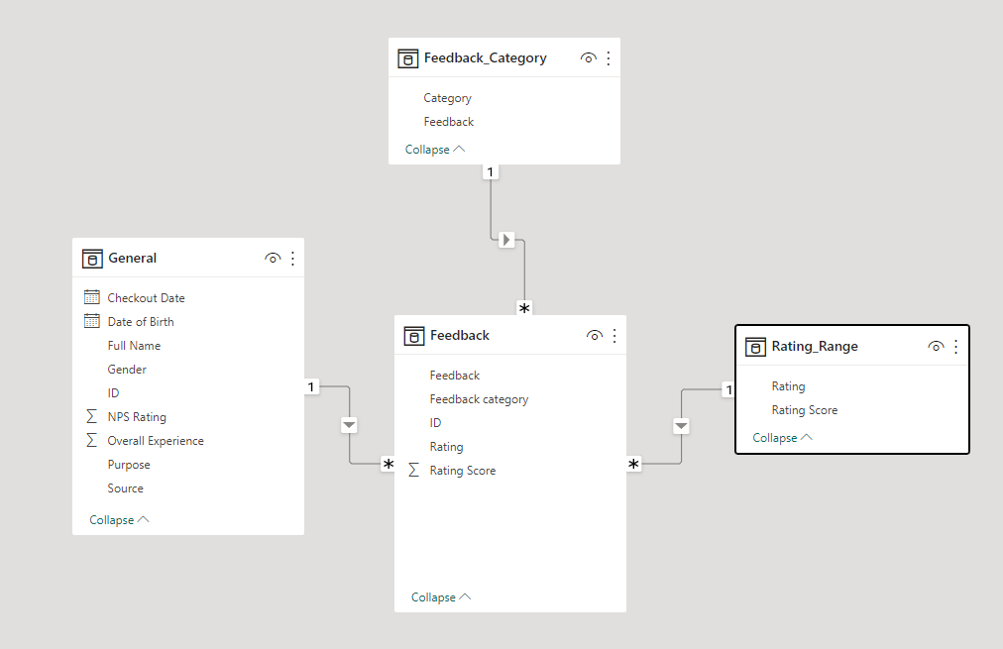
Manage Relationships
Not needed
(Already have merge feedback category and rating range)
Linked with ID
One to many relationship

Slide 12
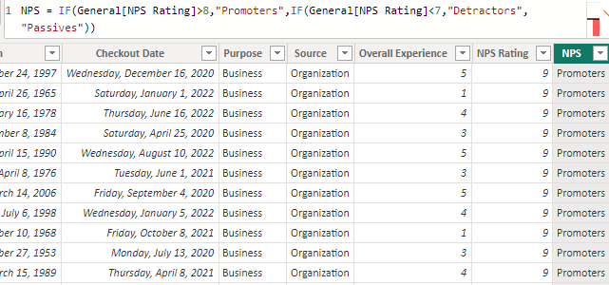
Data Analysis Expressions (DAX)
Promoters (9-10 rating)
Passives (7-8 rating)
Detractors (1-6 rating)
NPS = IF(General[NPS Rating]>8,"Promoters",IF(General[NPS Rating]<7,"Detractors","Passives"))
Determine NPS of each customers

Slide 13
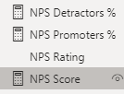
Creating measures for NPS Score
NPS = Percentage of Promoters - Percentage of Detractors

Slide 14
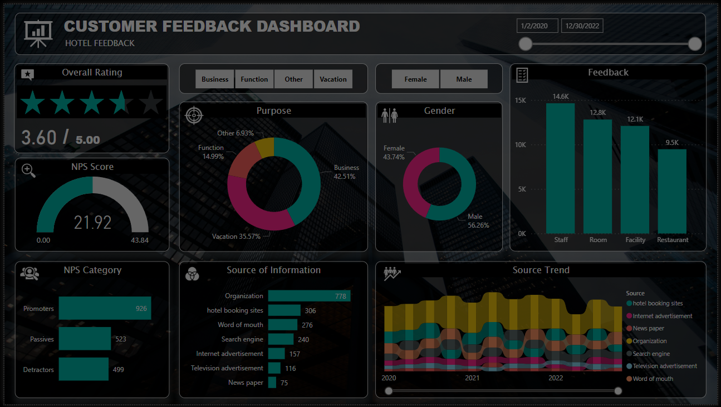
Set-up Dashboard
Notes:
After finished working with the data set. The next part is setting up the dashboard.

Slide 15
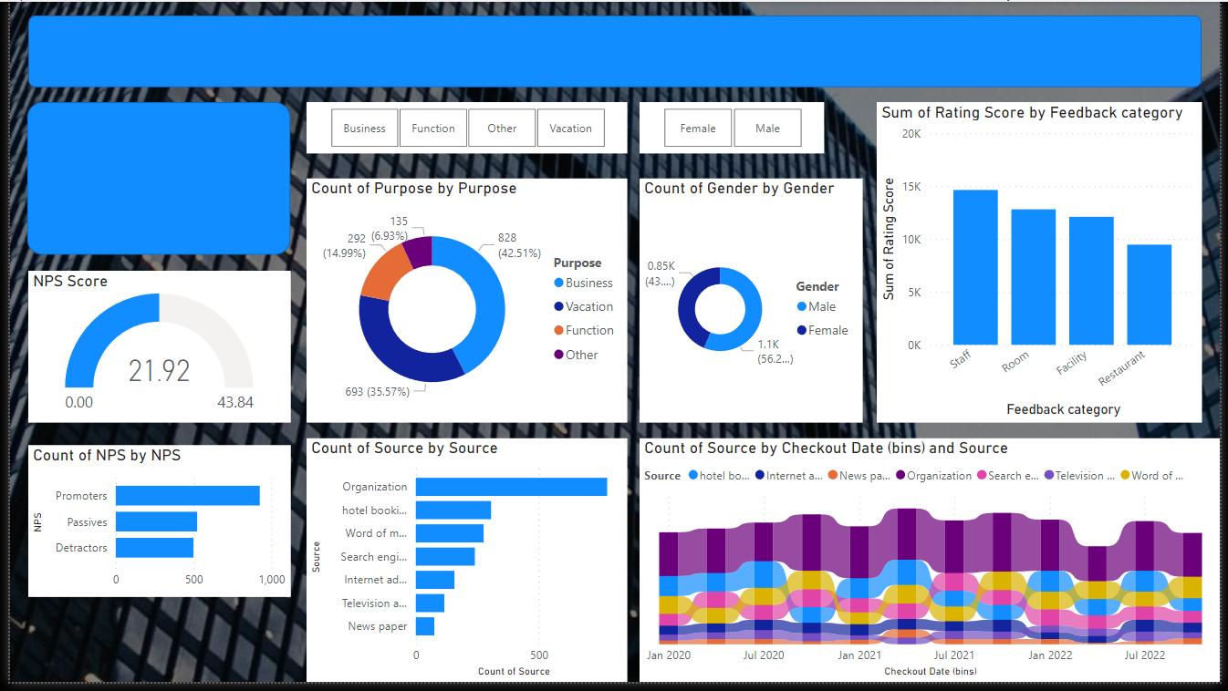
Add Visuals to Dashboard
Notes:
Firstly, we have to add visuals to the dashboard.
I add the background of the dashboard
and create the graphs
let’s take a look at each one of them
1. …next slide…

Slide 16
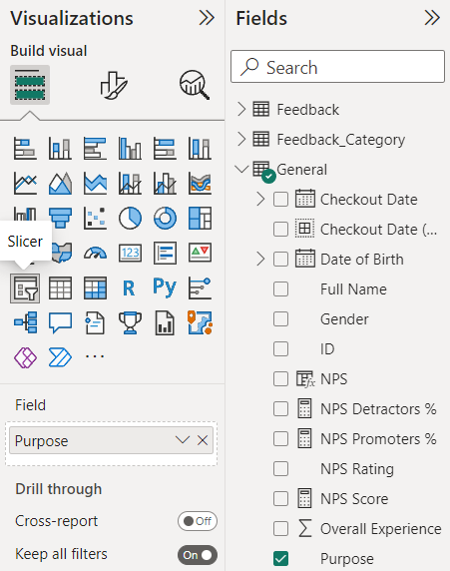
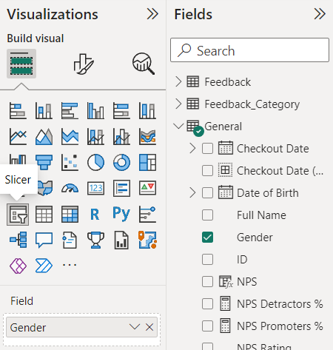
Slicer - Purpose
Slicer - Gender
↷
↶
Notes:
1,2)
These 2 are slicer; it works as a button to filtering the shown data
the first one is slicer of purpose
the second one is slicer of gender

Slide 17
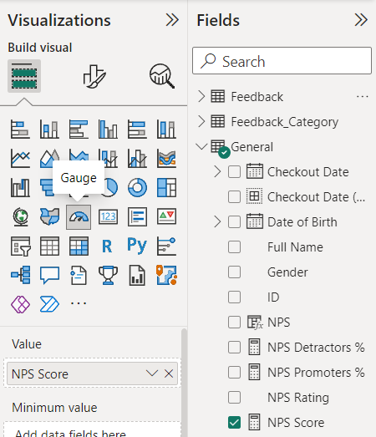
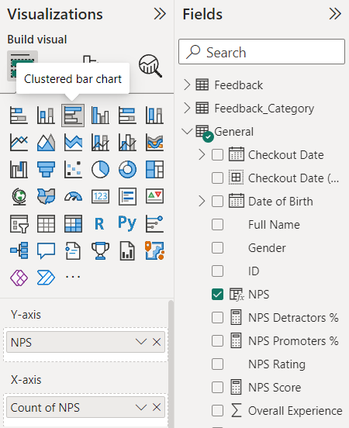
Gauge - NPS score
Clustered bar chart - count of NPS category
←
←
Notes:
3,4)
The graph at the top is a gauge of NPS score
The bottom one is a clustered bar chart shows a count of NPS category
In this case, we have 3 NPS categories and the bar is the count of each one

Slide 18
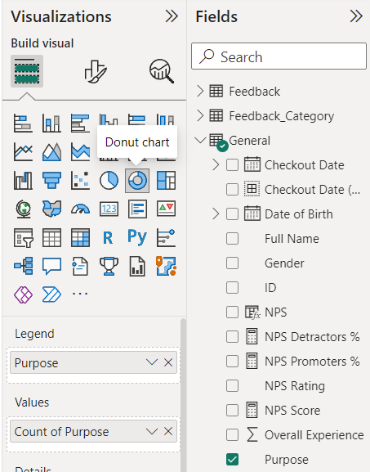
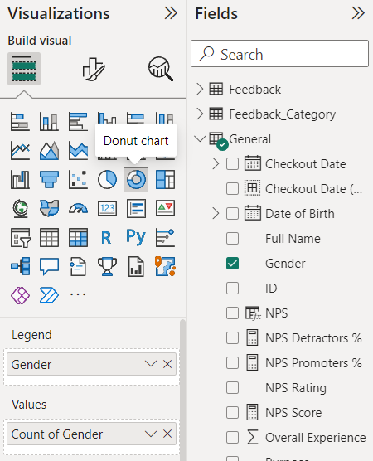
Donut chart - count of purpose
Donut chart - count of gender
↶
↷
Notes:
5,6)
These 2 graphs are both donut chart
The first one shows a count of purpose
And the second one shows a count of gender

Slide 19
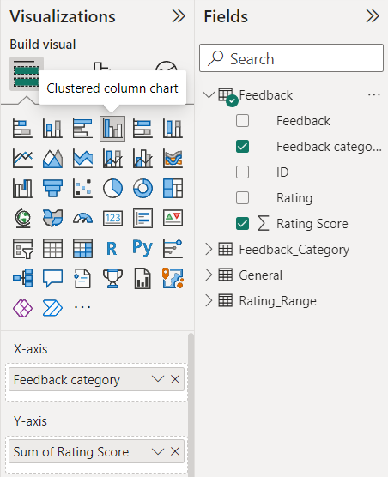
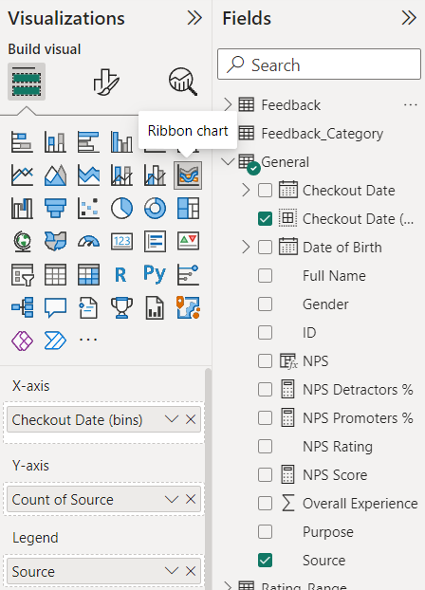
Clustered column chart - feedback (sum of rating score per each feedback category)
Ribbon chart - source trend
→
→
Notes:
7,8)
The graph at the top is a clustered column chart that shows the sum of rating score per each feedback category; This graph shows a feedback
The bottom one is a ribbon chart that shows a source trend; it is a count of source per each checkout date

Slide 20
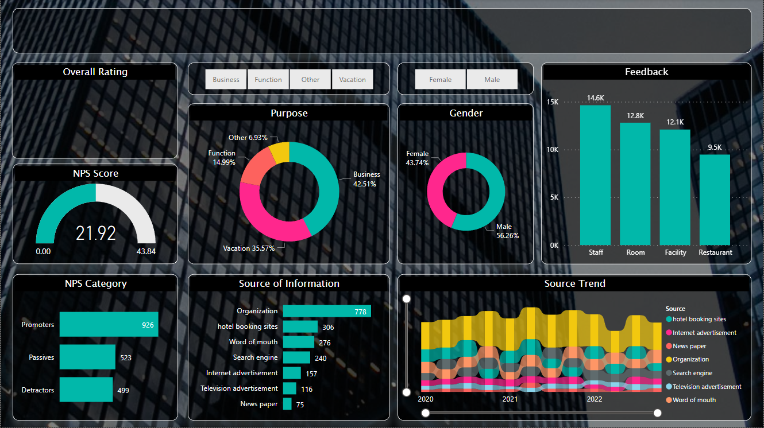
Notes:
Next, I set-up the theme
change color, format, and each graph title (I make it shorter and easier to read)
and now the graph started look a lot more better

Slide 21
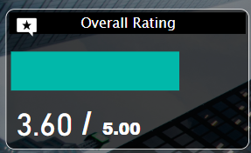
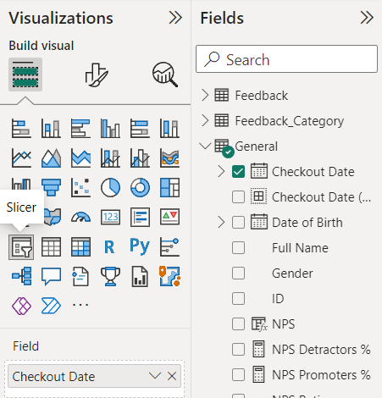
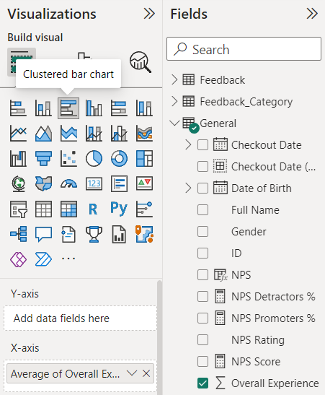
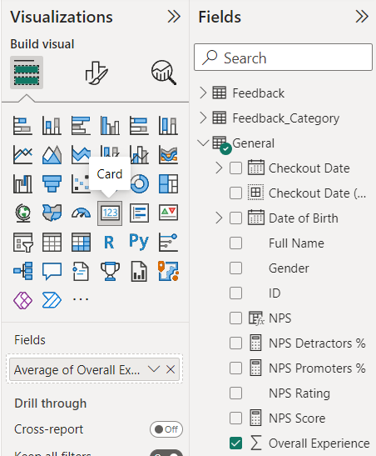
Title
Slicer of checkout date
Overall rating
↷
Notes:
After finish organizing visual, I add 3 more things: overall rating, slicer of checkout date for filtering, and the title of the dashboard (“Customer feedback dashboard”).
Overall rating
How do we get 3.6?
I use card to shows the average of overall experience <- In this case, we got 3.6 out of 5.
For the stars, I use clustered bar chart of overall experience and then insert a 5 stars icon on top of it
Slicer of checkout date
we can use it to filtering the information in the dashboard the same way as the first 2 slicers I mentioned before.

Slide 22
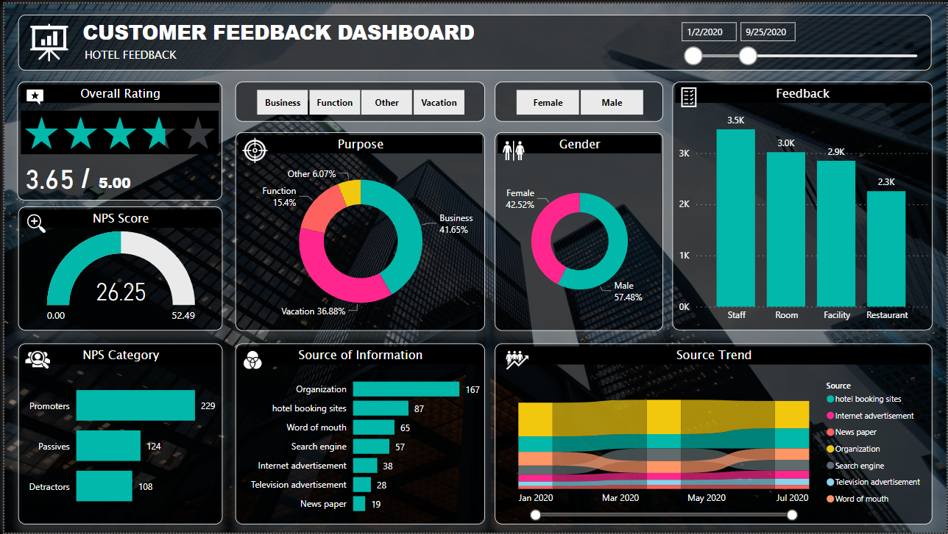
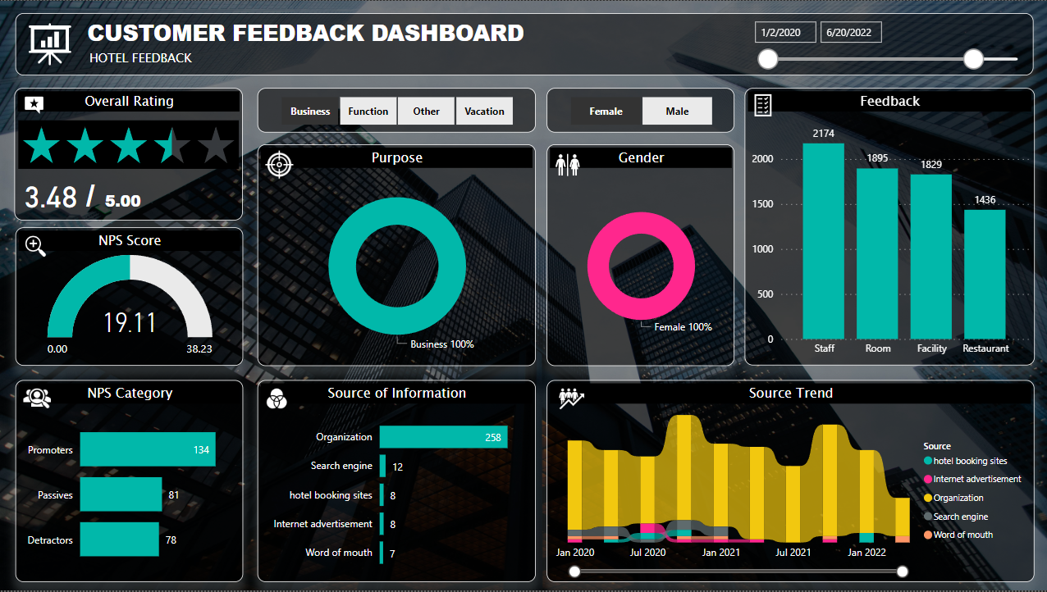
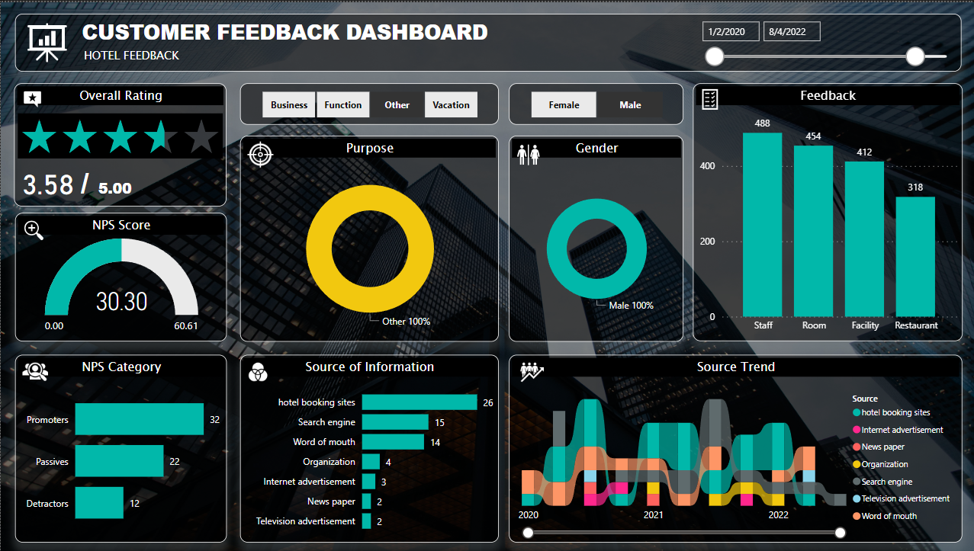
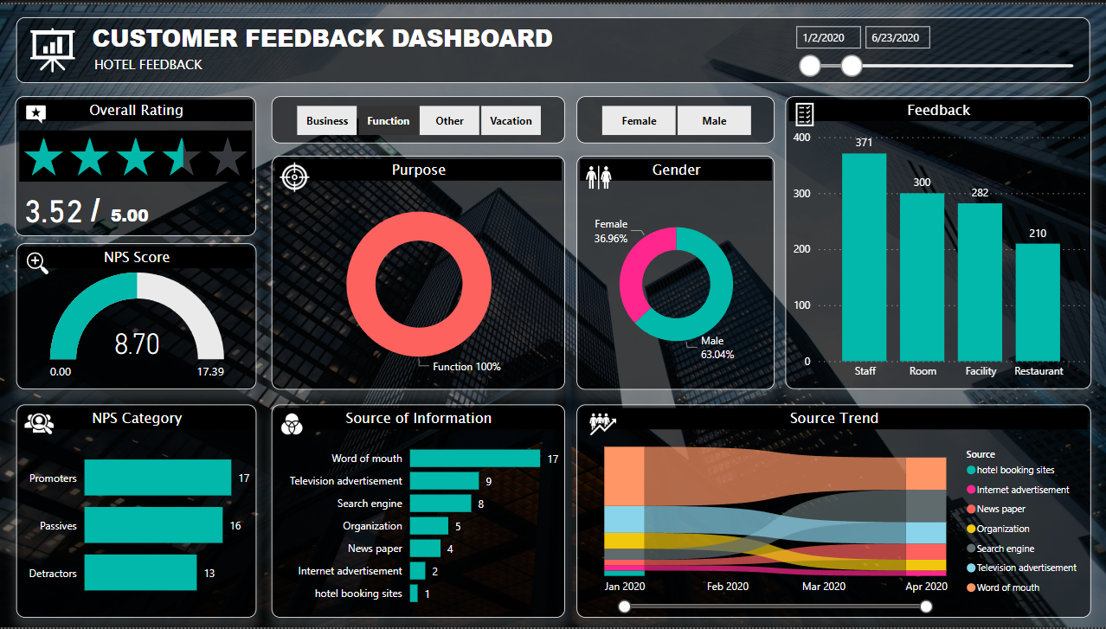
Examples of adjusting the slicers
Notes:
These are some of the examples of adjusting the slicers

Slide 23
Notes:
Done!

